Slide 1
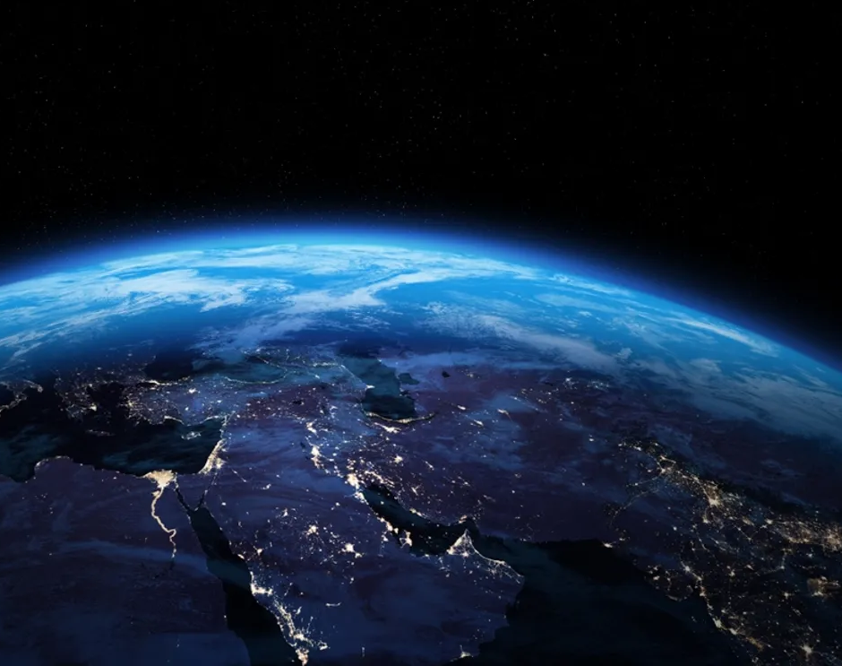
All The Earth Will Sing Your Praises

Slide 2
You lived, You died,
You said in three days You would rise
You did, You're alive

Slide 3
You rule, You reign
You said You're coming back again
I know You will

Slide 4
All the earth will sing Your praises
All the earth will sing Your Praises

Slide 5
You took, You take our sins away oh God
You give, You gave Your life away for us

Slide 6
You came down,
You saved us through the cross
Our hearts are changed
because of Your great love

Slide 7
You lived, You died,
You said in three days You would rise
You did, You're alive

Slide 8
You rule, You reign
You said You're coming back again
I know You will

Slide 9
All the earth will sing Your praises
All the earth will sing Your Praises

